Slide 1
Intel Unnati Industrial Training Program 2024
Basic Details of the Team and Problem Statement
Problem Statement 16: Running GenAI on Intel AI Laptops and Simple LLM Inference on CPU and fine-tuning of LLM Models using Intel® OpenVINO™
Category: Artificial Intelligence, Machine Learning, LLM, NLP
Team Name: CodeCrafters
Team Leader Name: Tanishk Soni
Institute Name: The Northcap University

Slide 2
Problem Statement
Fine-Tuning GPTNeo for Medical Text Generation Using a Specialized Medical Dataset
The project aims to fine-tune the GPTNeo model using a specialized medical dataset to generate coherent and contextually accurate medical text. This involves adapting the model to understand and produce medical narratives, patient summaries, and related documentation. The medical dataset consists of detailed descriptions of various medical conditions, their genetic underpinnings, symptoms, and treatment guidelines.
Key Objectives:
Preprocessing the Dataset: The dataset will be preprocessed through tokenization, stopword removal, punctuation stripping, and stemming. Additionally, n-grams will be created to enrich the model's input for better context understanding.
Fine-Tuning the GPTNeo Model: The preprocessed dataset will be used to fine-tune GPTNeo, enhancing its capability to generate medical texts that are not only grammatically correct but also contextually relevant.
Evaluating Model Performance: The fine-tuned model's performance will be evaluated based on its ability to generate realistic and contextually appropriate medical texts. Success will be determined by the model's utility for medical professionals in generating accurate clinical documentation.

Slide 3
Unique Idea Brief (Solution)
Our project, Advanced Medical Text Generation Application (AMTGA), introduces a novel approach to medical text generation by fine-tuning the GPTNeo model using a specialized medical dataset. This project is uniquely designed to meet the specific needs of healthcare professionals by providing accurate, contextually relevant, and coherent medical narratives, patient summaries, and related documentation.
Unique Aspects of Our Project:
Specialized Medical Dataset: Comprehensive descriptions of medical conditions, genetic underpinnings, symptoms, and treatment guidelines.
Advanced preprocessing: Utilizes tokenization, stopword removal, punctuation stripping, and stemming and n-grams to enhance text quality and relevance.
Contextually Accurate Text Generation: Fine-tuned to produce precise and contextually appropriate medical content.
Efficient Deployment with OpenVINO: Optimizes model performance for CPU infrastructure, enhancing scalability and reducing GPU dependency.
Interactive Input and Real-Time Refinement: Allows healthcare professionals to input patient details and refine medical context interactively.

Slide 4
Features Offered
Detailed Medical Knowledge: Covers conditions, genetics, symptoms, and treatments with specialized terminology.
Advanced Data Processing: Includes tokenization, stopword removal, punctuation handling, stemming, and n-gram analysis.
Contextually Accurate Generation: Fine-tuned GPTNeo model ensures precise and contextually relevant medical content.
Efficient Deployment: Optimizes for CPU infrastructure with OpenVINO technology, reducing GPU dependency.
Interactive Input: Allows real-time adjustments based on patient data and medical context.
Enhanced User Interface: Streamlines document creation and editing for improved productivity.
Automatic Summarization: Condenses complex medical reports into concise summaries for quick decision-making.
Workflow Efficiency: Enhances overall workflow in medical practices and research environments.

Slide 5
Process flow
Package Installation and Setup : Install necessary packages (transformers, torch, onnx, openvino-dev[onnx], etc.).
Loading and Saving Pre-trained Model and Tokenizer
Converting PyTorch Model to ONNX Format
Converting ONNX Model to OpenVINO IR Format: Use OpenVINO's Model Optimizer (ov.convert_model) to convert ONNX to IR format. Save the IR model as XML and BIN files (ov.save_model).
Preprocessing Dataset
Loading and Preparing Model for Fine-tuning
Exporting Fine-tuned Model to ONNX Format
Converting Fine-tuned ONNX Model to OpenVINO IR Format
OpenVINO IR Model Inference
Simple Fine-tuned Model Inference

Slide 6
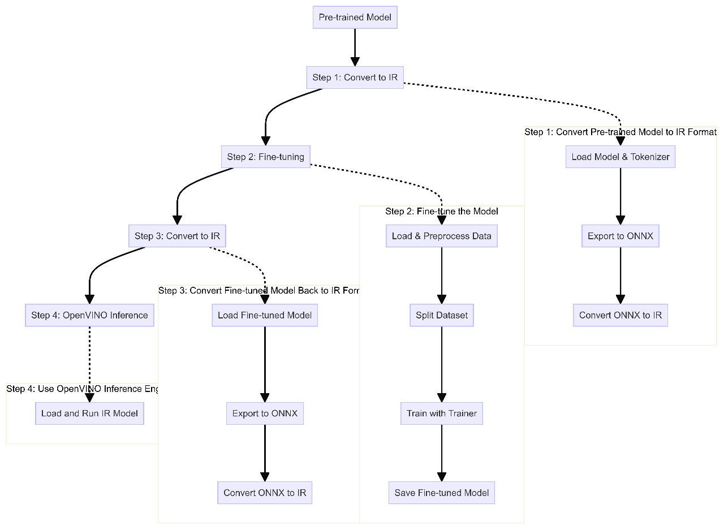
Architecture Diagram

Slide 7
Technologies used
Python: Programming language for script execution and automation.
Transformers: Natural language processing library for handling pre-trained models and tokenization.
PyTorch: Deep learning framework for model training and manipulation.
ONNX: Format for interoperability between different deep learning frameworks.
OpenVINO: Toolkit for optimizing and deploying models on Intel hardware.
Accelerate: Library for efficient training and distributed computing with PyTorch.
TRL (Text Representation Learning): Library for fine-tuning and training text representation models.
Pandas: Data manipulation and analysis tool, especially for handling structured data.
NumPy: Library for numerical computations and array operations.
scikit-learn: Machine learning library for dataset preprocessing and modeling.
Hugging Face Datasets: Library for managing and loading datasets for machine learning tasks.

Slide 8
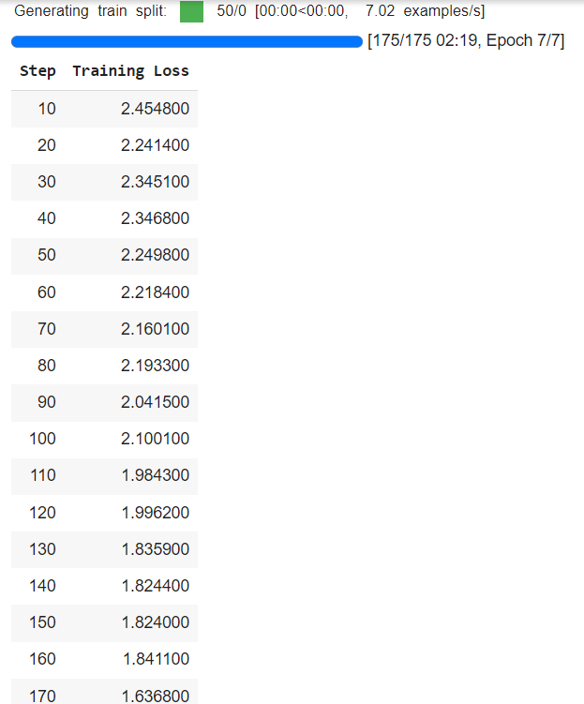
Output

Slide 9
Team members and contribution:
Tanishk Soni: Developed and optimized the GPTNeo model using a specialized medical dataset for accurate text generation.
Shivam Saini: Integrated the optimized model with OpenVINO for efficient CPU deployment, ensuring scalability and reduced GPU dependency.
Bhoomi Taneja: Designed and implemented an intuitive interface enabling real-time input and refinement of medical documentation, enhancing usability for healthcare professionals.

Slide 10
Conclusion
By leveraging OpenVINO, we have optimized and deployed our fine-tuned GPT-Neo model, allowing it to run efficiently on CPU infrastructure. This eliminates the dependency on high-cost GPU resources, making the model accessible and cost-effective for a broader range of users. The use of OpenVINO tools has enabled us to achieve significant performance gains, ensuring that our model can handle complex medical text generation tasks in real-time on standard computing hardware.
Our project, the Advanced Medical Text Generation Application (AMTGA), benefits immensely from these optimizations. The fine-tuned GPT-Neo model can generate detailed and contextually appropriate medical content, enhancing the quality of medical documentation.
The interactive document drafting feature allows healthcare professionals to input and refine patient information and medical contexts in real-time, making the drafting process more efficient and user-friendly.
Additionally, the intelligent summarization feature provides concise summaries of lengthy medical reports or research papers, saving time and improving workflow in medical settings.

